Slide 1


Continually learning out-of-distribution spatiotemporal data for robust energy forecasting
Dr. Arian Prabowo
Dr. Kaixuan Chen
Dr. Hao Xue
Dr. Subbu Sethuvenkatraman
Prof. Flora D. Salim

Slide 2
Energy use forecasting – Why?

Slide 3
Energy use forecasting – Why?
Australia has an energy market i.e. the price of electricity fluctuates according to supply and demand.

Slide 4
Energy use forecasting – Why?
Australia has an energy market i.e. the price of electricity fluctuates according to supply and demand.
Energy use forecasting is important to many stakeholders in the sectors. For examples:
Energy retailers need an accurate forecast to manage their infrastructure to effectively distribute electricity.
Building managers need an accurate forecast to efficiently schedule high energy operations e.g. pumping and heating water.
Power plants operator want to schedule maintenance only when the demand is low.

Slide 5
Energy use forecasting – Why?
Australia has an energy market i.e. the price of electricity fluctuates according to supply and demand.
Energy use forecasting is important to many stakeholders in the sectors.
Currently, the industry are only using traditional machine learning models.

Slide 6
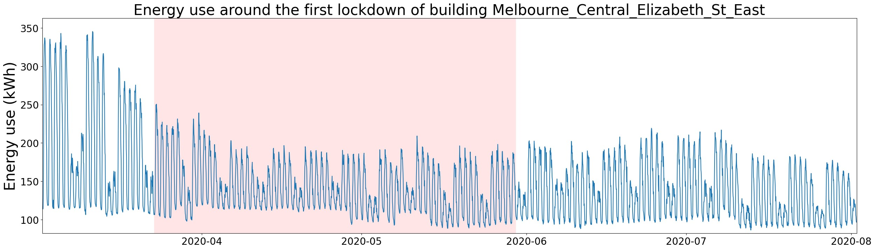
Extreme events (e.g. COVID-19) change the energy use distribution patterns
Before lockdown

Slide 7
Extreme events (e.g. COVID-19) change the energy use distribution patterns
Before lockdown
After lockdown

Slide 8
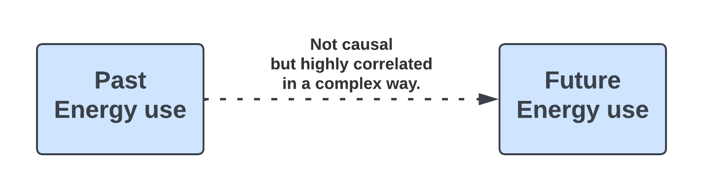
Extreme events (e.g. COVID-19) change the energy use distribution patterns

Slide 9
Extreme events (e.g. COVID-19) change the energy use distribution patterns
However, the complex correlation changes because of the changes in distribution due to lockdown.

Slide 10
Extreme events (e.g. COVID-19) change the energy use distribution patterns
We use continual learning to adapt to the changes in correlation due to changes in distribution.

Slide 11
Continual Learning
Traditional / Offline Learning | Continual Learning
Models are only trained once. Suffers when there are changes in distribution.

Slide 12
Continual Learning
Traditional / Offline Learning | Continual Learning
Models are only trained once. Suffers when there are changes in distribution. | Models are updated as new data comes in. Adaptive to changes in distribution.

Slide 13
We use continual learning to perform accurate forecast even during OoD periods

Slide 14
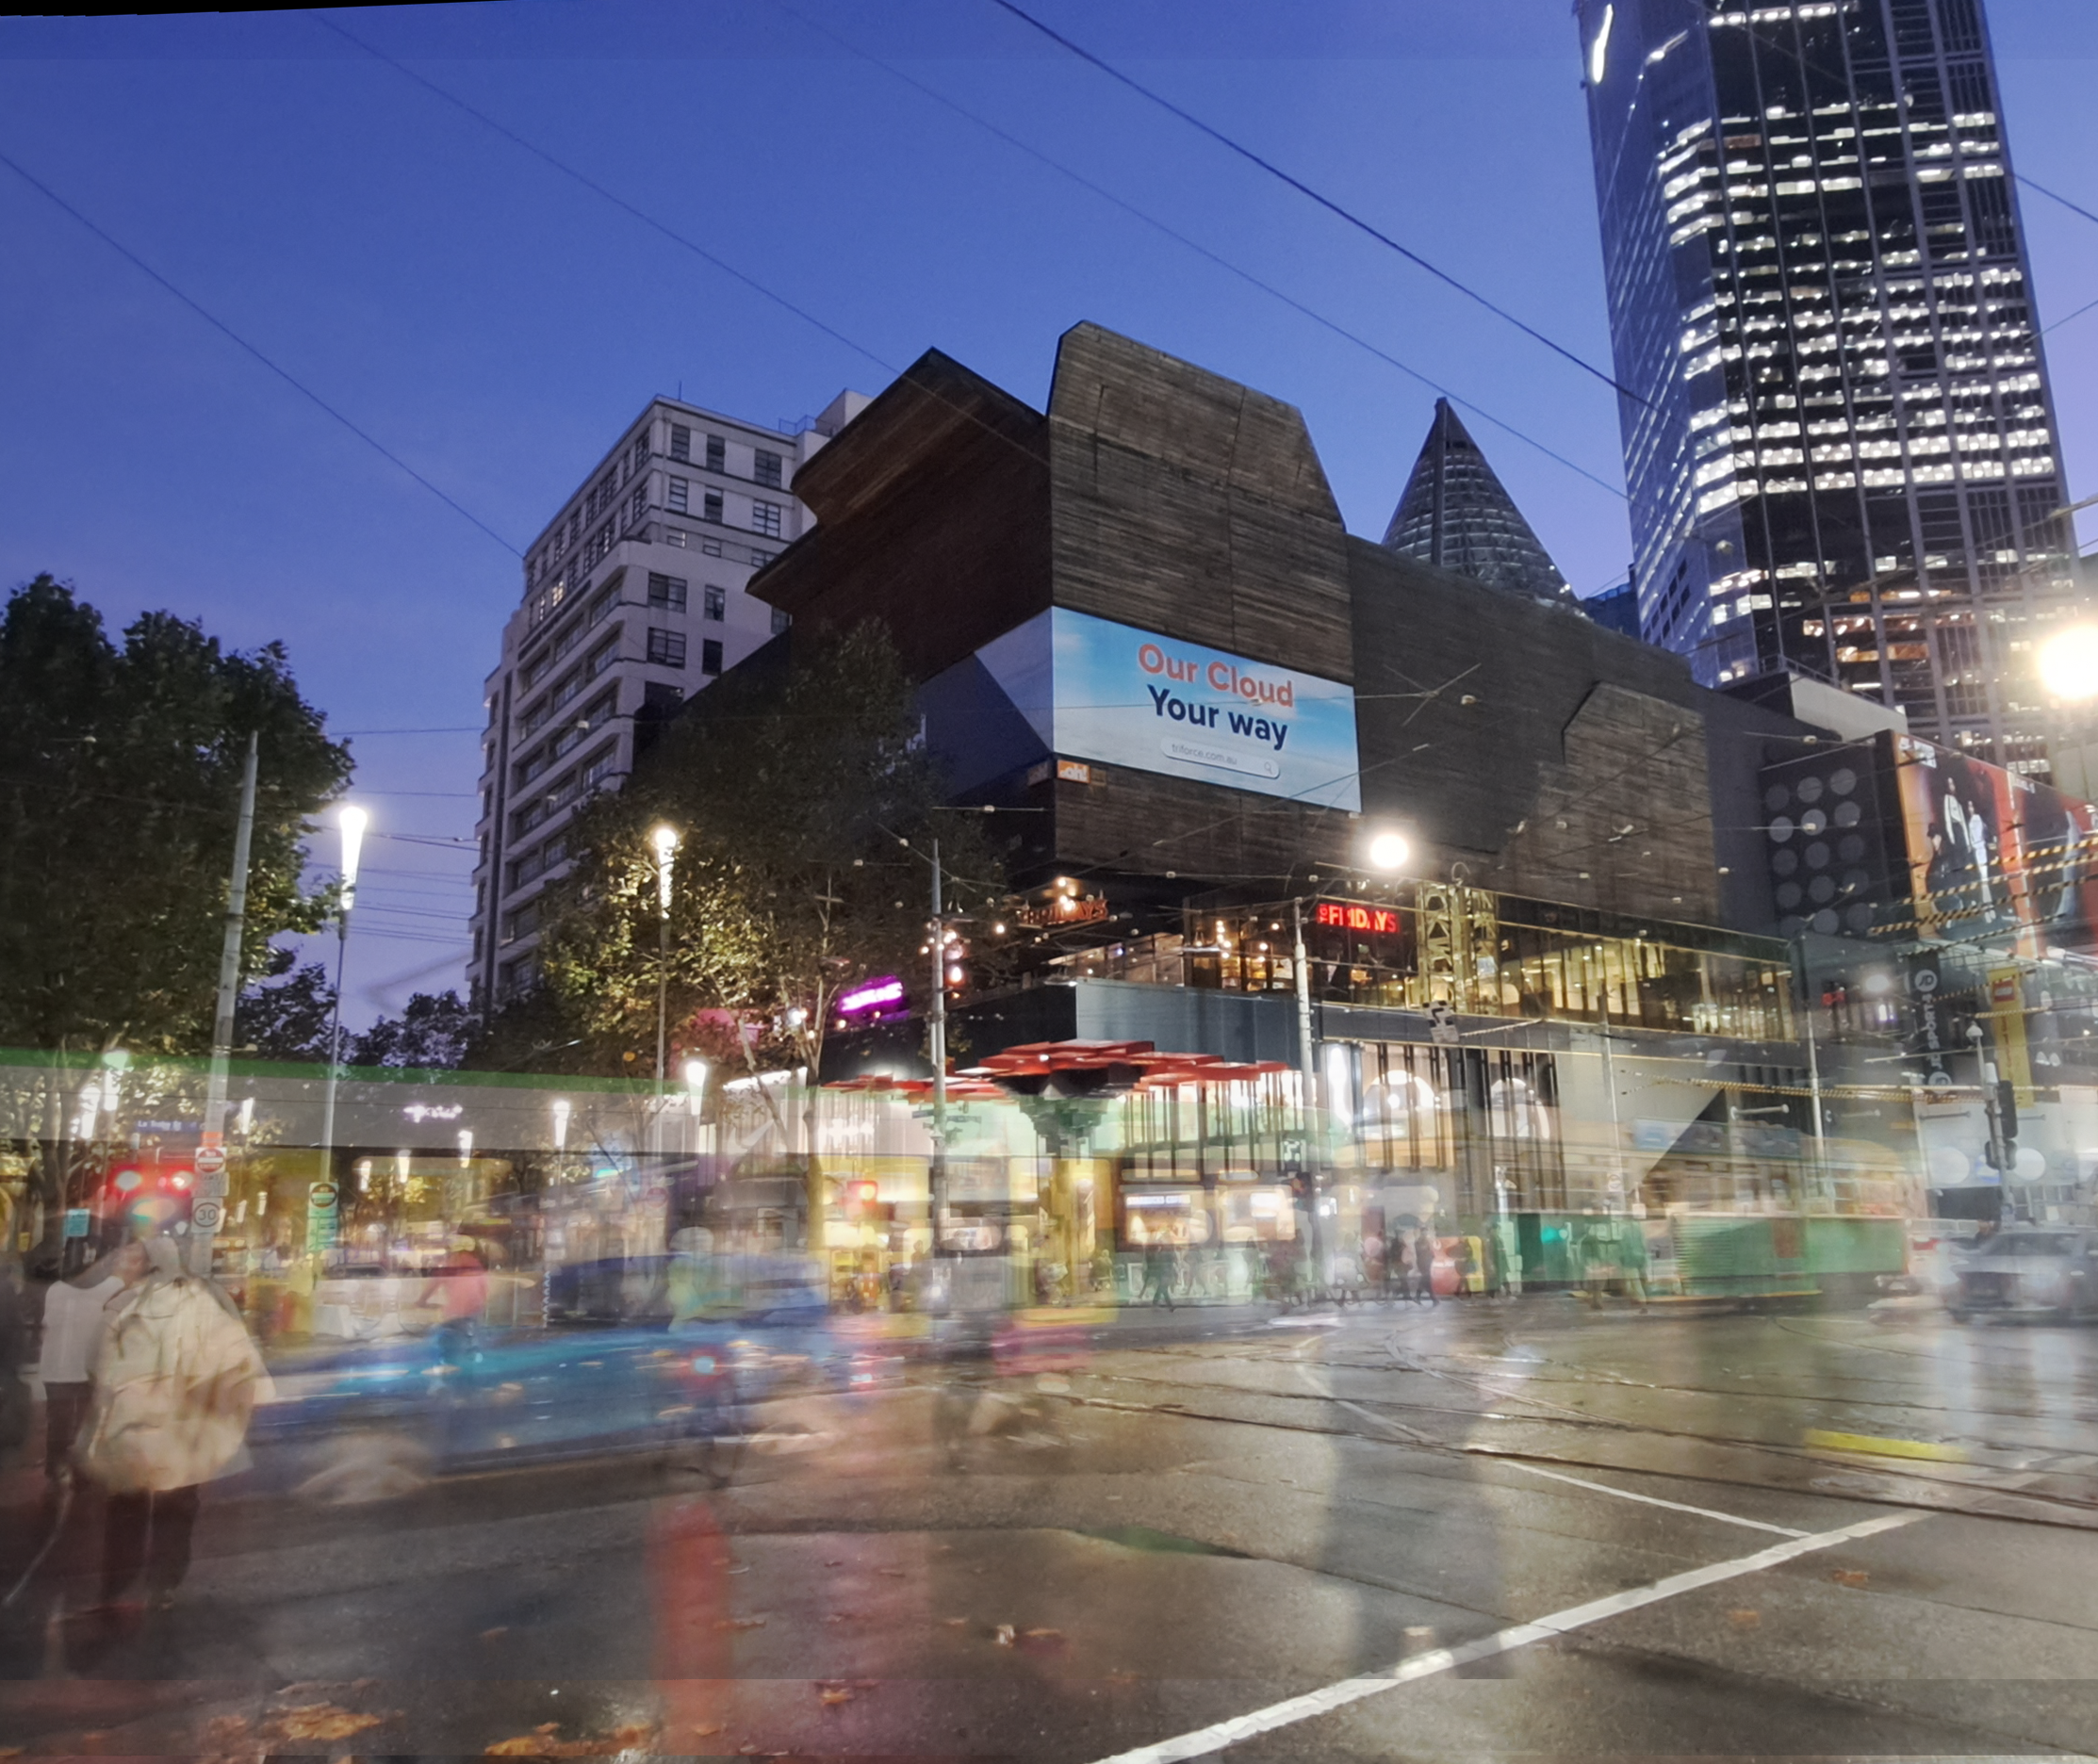
Datasets: Energy
4 Building Complexes (BC)
To protect privacy, we aggregate nearby buildings, even with different building use (e.g. retail/office/residential), into one BC.

Slide 15
Datasets: Energy
4 Building Complexes (BC)
To protect privacy, we aggregate nearby buildings, even with different building use (e.g. retail/office/residential), into one BC.
All from Melbourne, Australia.
The city which experienced one of the longest and strictest COVID lockdown.

Slide 16
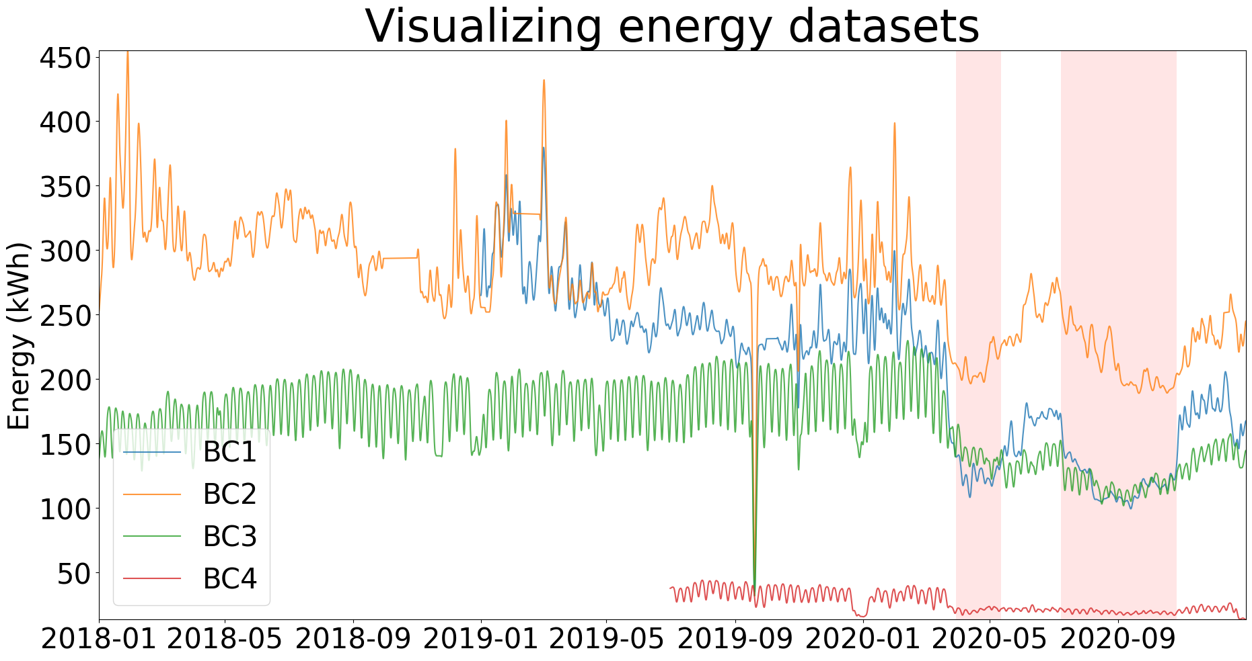
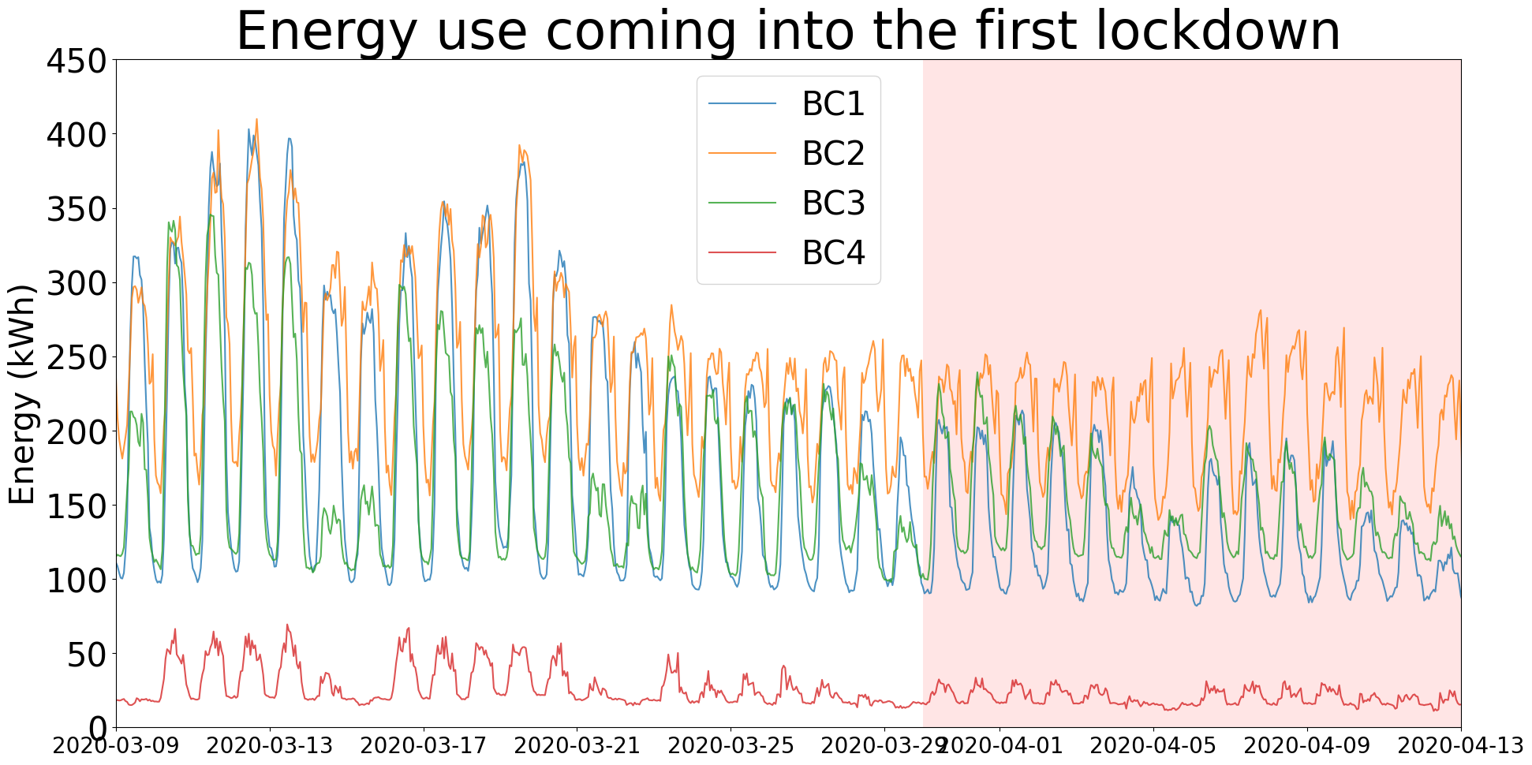
Datasets: Energy
The top plot is smoothed.
The dataset selection
is diverse.
They all have different distributions.

Slide 17
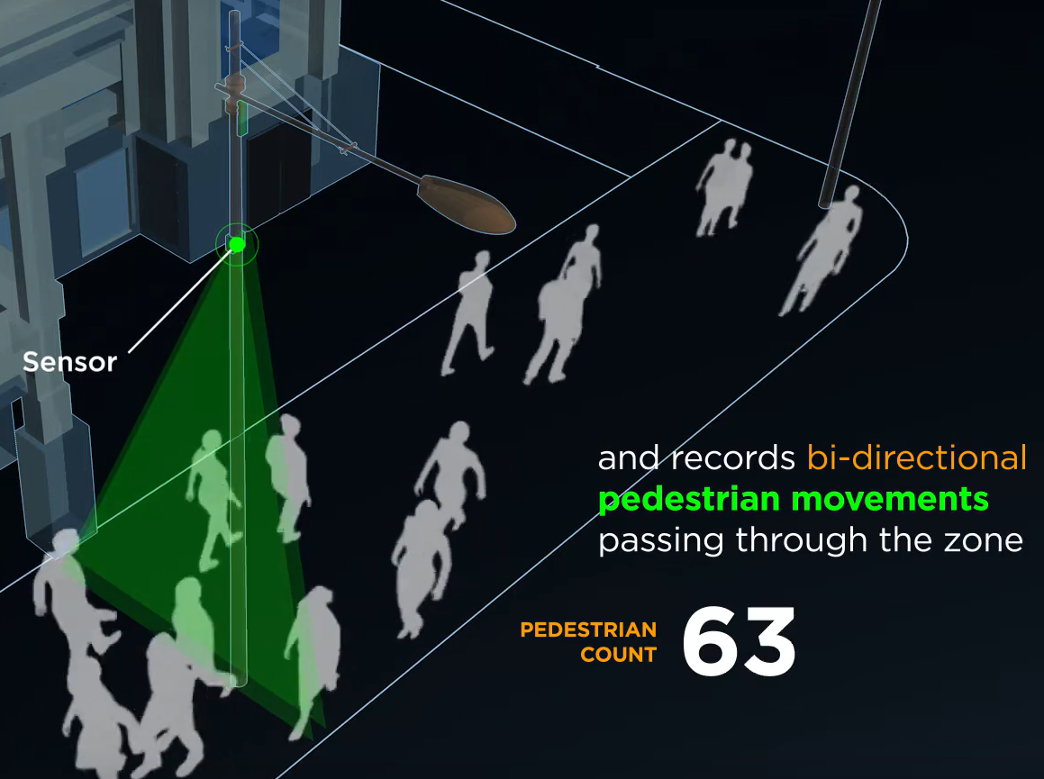
Datasets: Mobility
Installed in public space for by the City of Melbourne.
Does not capture images or videos to protect privacy.
Publicly available, thus useful for stakeholders without access to data from inside the buildings e.g. energy retailer and power plants operator.

Slide 18
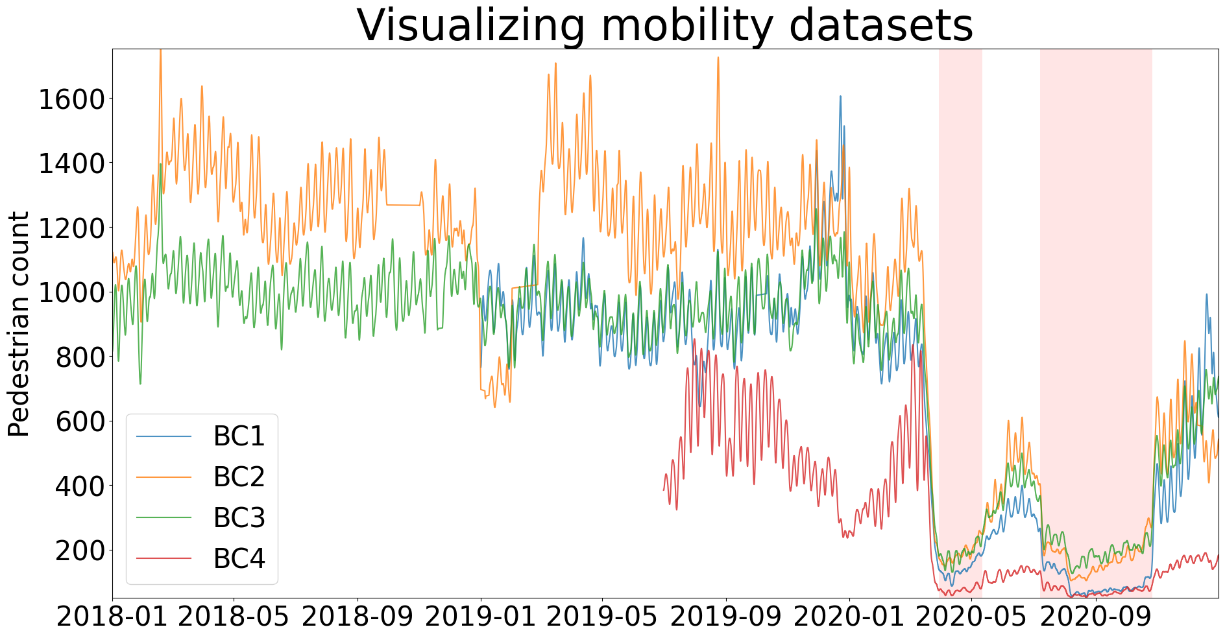
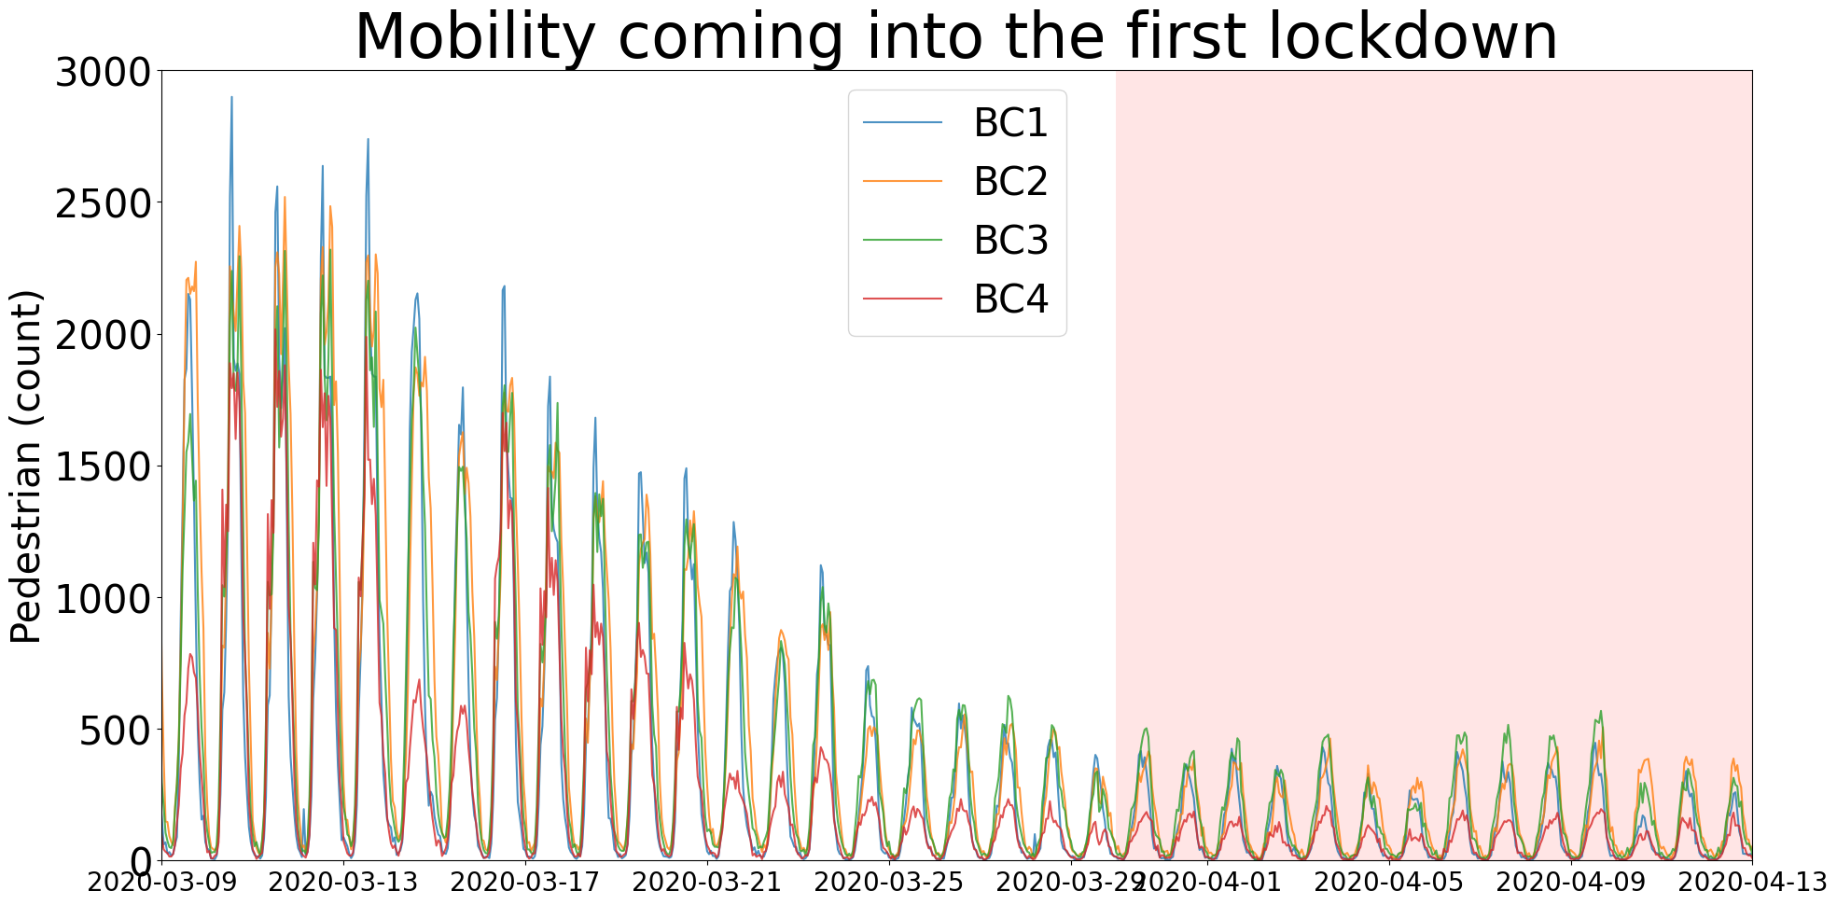
Datasets: Mobility
The top plot is smoothed.
The dataset selection
is diverse.
They all have different distributions.

Slide 19
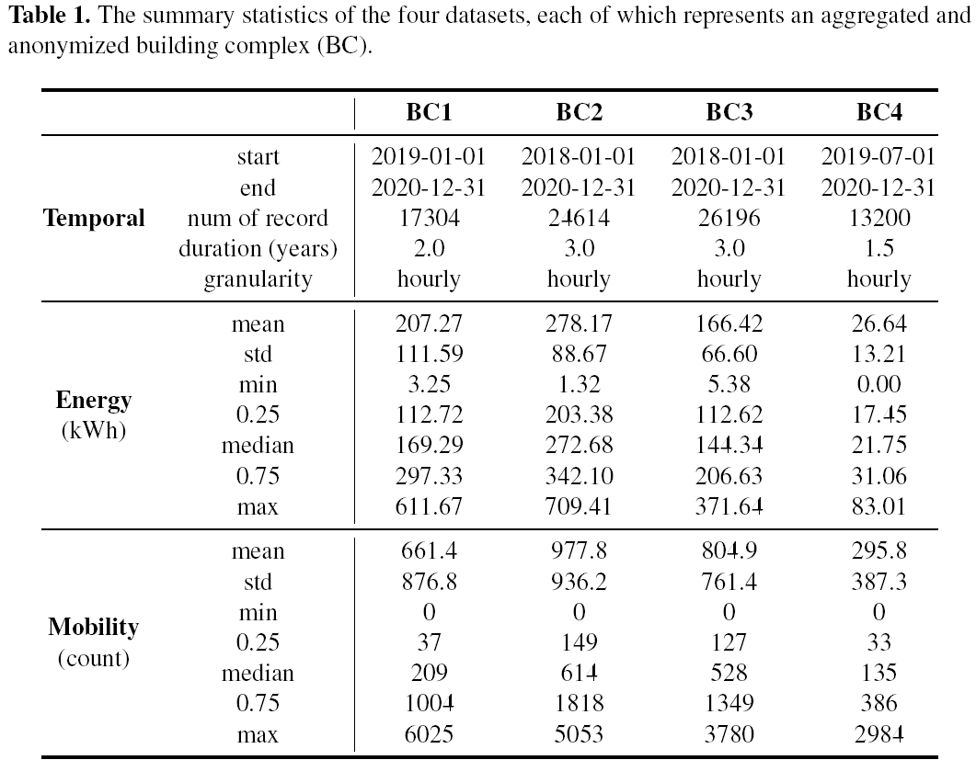

Slide 20
Experimental setup
Last 24 hours as input to forecast the next 24 hours (i.e. autoregressive)
We also have temperature data
We divide our data into two periods: pre- and post- Lockdown
We compare 4 different CL methods implemented on a TCN backbone.

Slide 21
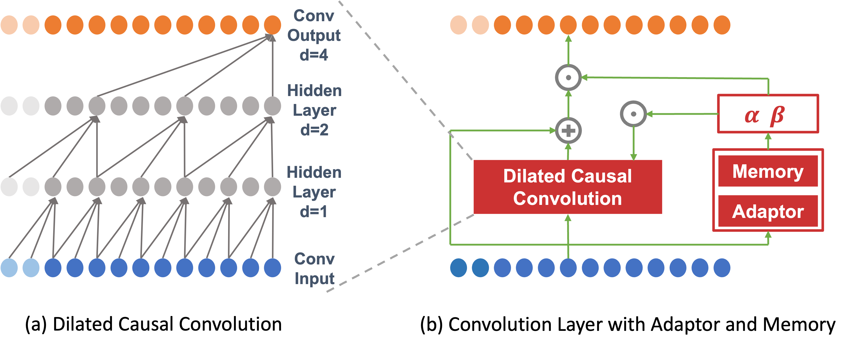
(Temporal Convolutional Network) TCN
TCN is a popular convolutional architecture in timeseries. (sometimes also known as WaveNet)
The dilation operation exponentially increase receptive field of subsequent layers.
The causal part means that the receptive field is only over preceding nodes, so they are not exposed to data from the future.

Slide 22
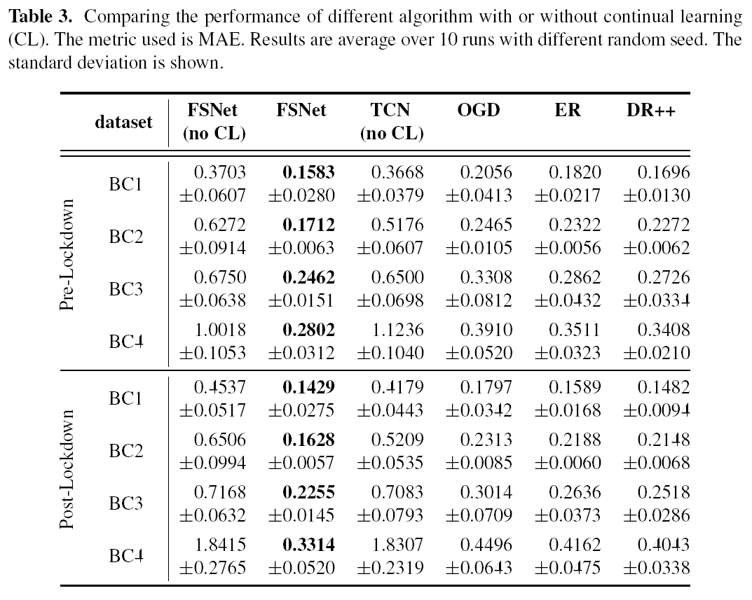
Without CL, DL perform worse after lockdown.
FSNet is consistently the best

Slide 23
FSNet architecture with TCN backbone

Slide 24
FSNet architecture with TCN backbone
Updating the entire model (OGD) whenever there’s a new data is inefficient, and risk catastrophic forgetting where the model forget how to perform well on older task / distribution.

Slide 25
FSNet architecture with TCN backbone
Updating the entire model whenever there’s a new data is inefficient, and risk catastrophic forgetting.
So we only update the memory module.
And the adapter module decides when to update the memory module.

Slide 26
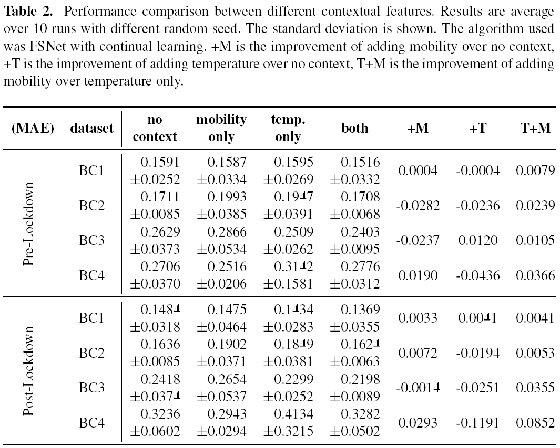
Mobility is important, especially post-Lockdown, especially with temperature. Although the size of the improvement varied between BCs.

Slide 27
Current work ECML PKDD ADS 2023
Follow up work
BuildSys 2023
4 Building Complexes
2 periods:
Pre-lockdown
Post-lockdown
4 Continual Learning methods
13 Building Complexes
5 periods:
Pre-lockdown
1st lockdown
Inter-lockdown 1
2nd lockdown
Inter-lockdown 2
13 methods
Naïve, statistical, classical ML, deep learning, online learning, and continual learning.

Slide 28


Thank you. Questions?
Link to this paper
Conclusion:
For energy forecasting during anomalous periods:
Mobility data is at least as important as temperature, and it complements temperature.
Continual learning is superior even before lockdown, and it is even more pronounced after lockdown. Among all CL methods, FSNet has superior performance.
Link to our follow up work, with 13 datasets!

Slide 29
